Slide 1
User Analysis
Part II of efood assessment

Slide 2
Target of the analysis
Get to understand the customers
Group them according to their traits
Identify the best customer segment to target a breakfast campaign

Slide 3
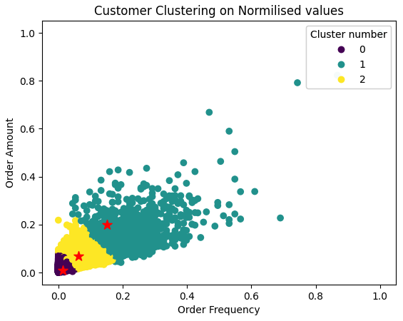
Grouping the customers
Customers having placed at least one breakfast order
Values not the actual ones, but normalized to achieve more accurate results
3 customer groups
Low amount and low frequency, 45000 customers
Medium amount and frequency, 9100 customers
High amount and frequency, 1800 customers

Slide 4
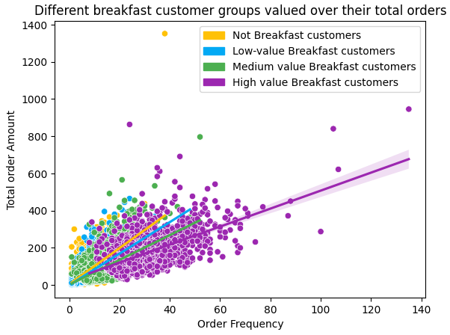
Group’s performance in all the cuisines
High valued breakfast customers are indeed the most loyal customers in general!
66.000 customers have never ordered breakfast, but generally have high order amount!

Slide 5
Since breakfast is proven to contribute to customer’s loyalty, its easy to assume that the breakfast campaign should be targeting customers that have not yet placed a breakfast order, but nevertheless, they have high ordering frequency

Slide 6
Suggested campaign target

Slide 7
Thank You for attending

